Slide 1
Parallel Joins

Slide 2
Join operation: Pairs of tuples are tested to see if they satisfy the join condition, and if they do, the pair is added to the join output
Parallel join operation steps:
Partitioning: split the pairs to be tested over several processors
Parallel Joins: Each processor then computes part of the join locally
Result Collection: Finally the results from each processor are collected together to produce the final result.

Slide 3
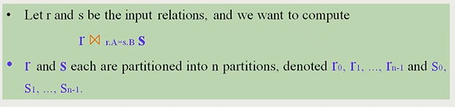
Partitioned Join
For Equi-joins and Natural joins:
it is possible to partition the two input relations across the processors, and compute the join locally at each processor.

Slide 4
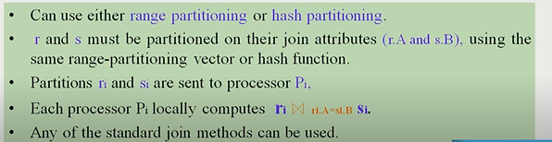
Relation r and s each are partitioned into n partitions, denoted r0, r1,…..rn-1 and s0, s1,…..sn-1.

Slide 5
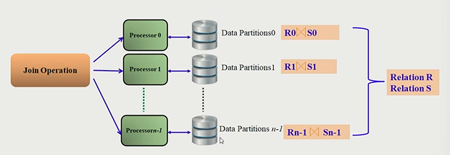

Slide 6
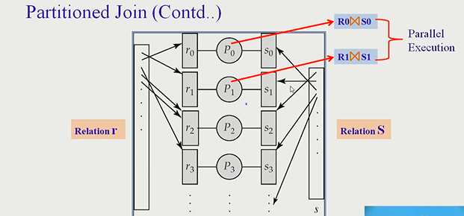

Slide 7
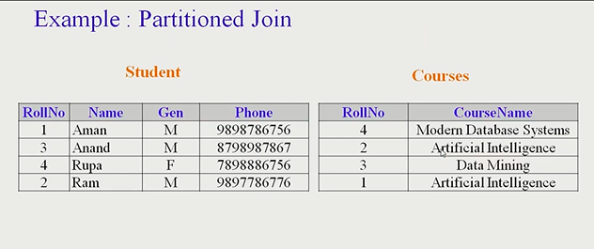
Example

Slide 8
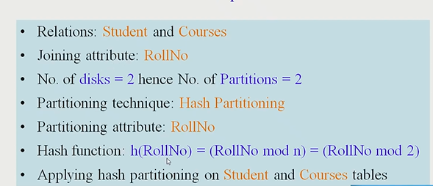

Slide 9
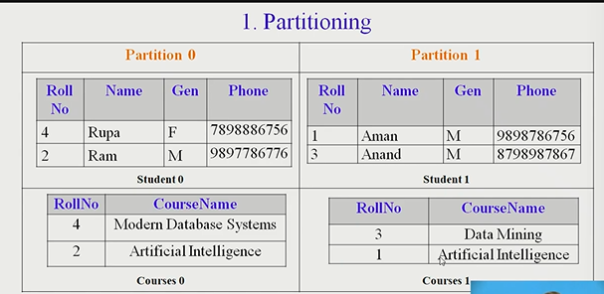

Slide 10
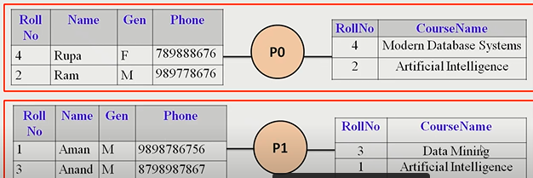

Slide 11
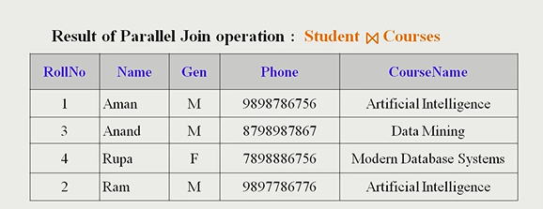

Slide 12
Fragment and Replicate join
Partitioning not possible for some join conditions.
Example ., non-equijoin conditions, such as r.A > s.B
Condition is established using all comparison operators except the equal (=) operator. Like !=, >=,<=,<,>

Slide 13
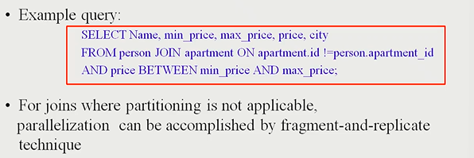

Slide 14
Special Case- asymmetric fragment and replicate
one of the relations, say r, is partitioned
any partitioning technique can be used
the other relation, s , is replicated across the processors
Processor pi then locally computes the join of ri with all of s using any join technique.

Slide 15
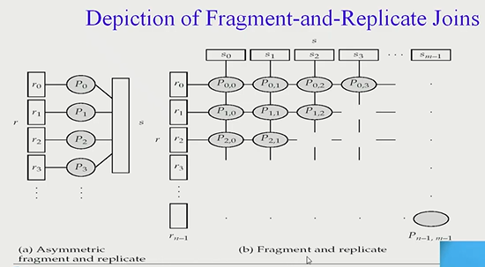

Slide 16
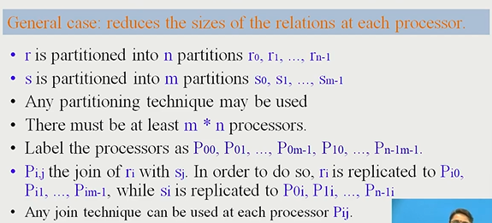

Slide 17
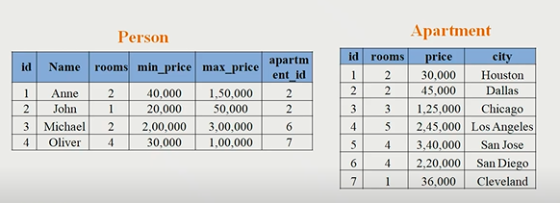

Example Relations

Slide 18
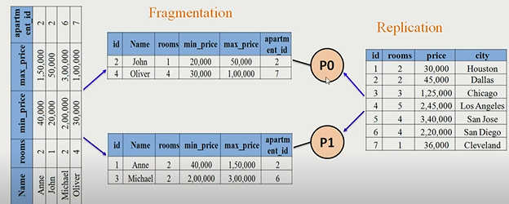

Slide 19
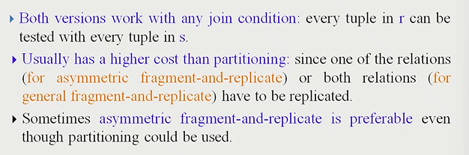

Slide 20
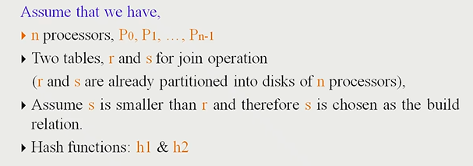
Partitioned Parallel Hash join

Slide 21
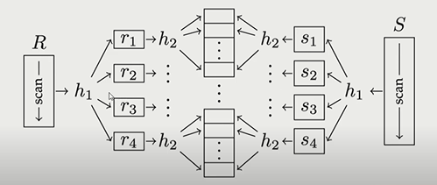

Slide 22
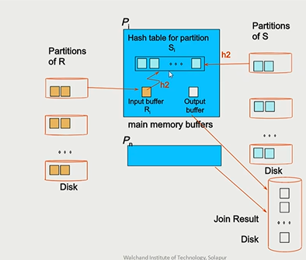

Slide 23
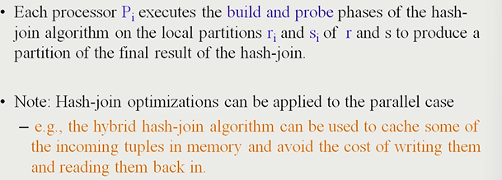

Slide 24
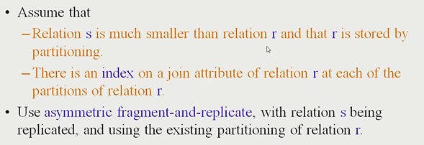
Parallel Nested- Loop Join

Slide 25
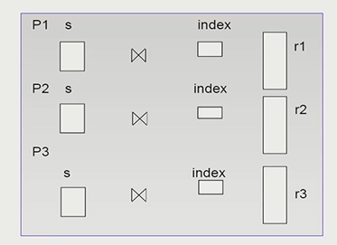

Slide 26
